Slide 1
Shifting Borders-Analyzing U.S. Immigration Trends through the Years
Precious M., Justin P., and Claudio D.

Slide 2
Introduction
When you think about what makes America, AMERICA, certain thoughts come to mind. Most importantly our diverse population. Well, we didn’t all get here by magic. One person or a group of people, a family perhaps, migrated here for a multitude of reasons i.e. fleeing violence, poverty, and ultimately seeking opportunity. We are a nation of immigrants, and have been since our conception.
Our project centers around this defining feature of American life by exploring immigration trends in the United States, using data collected by U.S. Customs and Border Protection’s Office of Field Operations (OFO). Our focus begins in 2004, a pivotal year in the modern immigration landscape.

Slide 3
Why does our data start in 2004?
To grasp, the importance of our data we must paint the picture of what was going on in the United States immigration landscape, pre-2004.

Slide 4
PRE–2004 Immigration Landscape
Long story short, the immigration story of America begins with the first settlers from Europe that were mostly fleeing to escape religious persecution. As decades and centuries past the “New Americans” started to find way to keep certain people out while allowing others to make America home. Thus forming the infancy of what we know as our Immigration Policy.
One example being the Chinese Exclusion Act of 1882 was past that excluded Chinese laborers from being able to migrate here for fear of that they would “take our jobs”. Sounds familiar, doesn’t it?

Slide 5
PRE–2004 Immigration Landscape, cont’d.
While purposely excluding others, the immigration policy of the United States at the time did favor other rational groups, mostly white, Anglo-Saxon, Protestant (W.A.S.P.) Europeans.
Fast forward to now, maybe the sentiment of wanting to keep people out is just as American as they come. But over time, mostly after the Immigration and Nationality Act of 1965, the U.S. worked to remove it’s racist racially motivated quotas. Official borders were created and America seemed more open to Asylum seekers.
Things began to change on 9/11/2001.
Immigration policy became synonymous with National Security.
The Bush Administration created the Department of Homeland Security in 2002. And border control and enforcement became more aggressive, and militant.

Slide 6
2004–The Turning Point.
The reason our graph starts in 2004 is because it marks the beginning of a new era in U.S. immigration policy — one defined by heightened national security and data collection following the 9/11 attacks.
By 2004, new post-9/11 policies were fully in effect, reshaping how immigration was tracked, processed, and reported.

Slide 7
POST–2004 Immigration Landscape
From 2004 onward, immigration patterns fluctuated in response to political leadership, global conflicts, economic shifts, and humanitarian crises. For instance:
In 2015, the U.S. saw a surge in unaccompanied minors and family units from Central America.
The COVID-19 pandemic (2020–2021) disrupted migration drastically.
In recent years, increased migration from Venezuela, Haiti, and Nicaragua has reshaped the encounter landscape.

Slide 8
ABOUT OUR DATASET
The dataset we’re analyzing is sourced from the KHSM Encounters (OFO) reports and contains encounter-level data tracked by:
Fiscal Year
Region
Quantity: Number of Encounters

Slide 9
Research Questions
How have total border encounters changed over time (2004–present)?
Questions that came up while we were analyzing.
Why does our data start in 2004?
What happened in 2004?
Which nationalities are most commonly encountered and how have they shifted over time?
Are there regional patterns in encounter trends — and which field offices process the highest volumes?
Can you paint the picture of these boarders and where they are located so that we can have more information on them?

Slide 10
First things first, let’s see the data!
After speaking with Dr. Shoemaker we decided to use a spagetti graph to display our data because we learned that is the best way to display and analyse our data. A spagetti graph would allow us to visualize how border encounters have changed over time across multiple regions simultaneously.

Slide 11
Load ’her up!…
## ## Attaching package: 'dplyr'
## The following objects are masked from 'package:stats': ## ## filter, lag
## The following objects are masked from 'package:base': ## ## intersect, setdiff, setequal, union
## Warning: package 'ggplot2' was built under R version 4.4.3

Slide 12
** …To take a peek!**
## Rows: 88 ## Columns: 3 ## $ `Fiscal\r\nYear` <dbl> 2004, 2004, 2004, 2004, 2005, 2005, 2005, 2005, 2006,… ## $ Region <chr> "Air Ports of Entry/Interior", "Coastal Border", "Nor… ## $ Quantity <dbl> 38030, 1400, 59640, 71450, 78420, 2640, 72290, 97860,…

Slide 13
Now what are the column names?
## [1] "Fiscal\r\nYear" "Region" "Quantity"

Slide 14
How many regions are there? What are their names?
## [1] 4
## # A tibble: 4 × 1 ## Region ## <chr> ## 1 Air Ports of Entry/Interior ## 2 Coastal Border ## 3 Northern Land Border ## 4 Southwest Land Border

Slide 15
Now we have an idea of what the dataset contains we want to visualize it.
Let’s get the full view of the data.
## [1] 4
## # A tibble: 88 × 3 ## Year Region Encounters ## <dbl> <chr> <dbl> ## 1 2004 Air Ports of Entry/Interior 38030 ## 2 2004 Coastal Border 1400 ## 3 2004 Northern Land Border 59640 ## 4 2004 Southwest Land Border 71450 ## 5 2005 Air Ports of Entry/Interior 78420 ## 6 2005 Coastal Border 2640 ## 7 2005 Northern Land Border 72290 ## 8 2005 Southwest Land Border 97860 ## 9 2006 Air Ports of Entry/Interior 48920 ## 10 2006 Coastal Border 3810 ## # ℹ 78 more rows

Slide 16


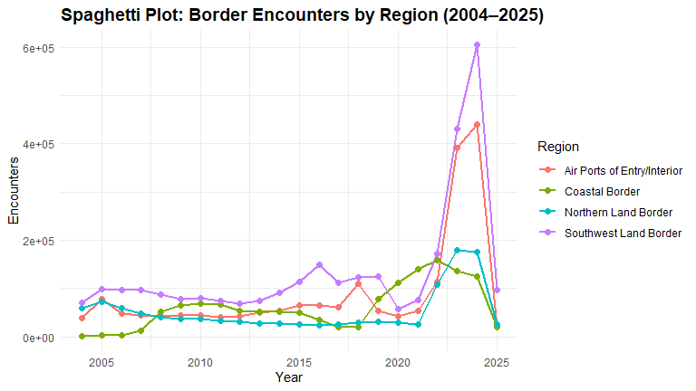


Slide 17
Let’s break down the borders?
The Air Ports of Entry/ Interior:
Location- Nationwide: International Airports.
Consists of Travelers arriving via air.
The Coastal Border:
Location: U.S. coastlines and maritime entry points.
Consists of Travelers arriving from Florida, Puerto Rico, U.S. Virgin Islands, Gulf Coast, and some Atlantic seaports.
The Northern Land Border:
Location: U.S.–Canada land crossings.
Consists of Travelers arriving from Border stations–Vehicle, rail, and pedestrian crossings– in states like Washington, Michigan, New York, Vermont, and Maine.
The Southwest Land Border:
Location: U.S.–Mexico land crossings.
Consists of Travelers arriving from Texas (El Paso, Laredo, Rio Grande), Arizona (Tucson, Yuma), New Mexico, and Southern California (San Diego).

Slide 18
With that in mind, what is this data is telling us?
Let’s zoom in on the action for a sec.
## [1] 4
## # A tibble: 48 × 3 ## Year Region Encounters ## <dbl> <chr> <dbl> ## 1 2014 Air Ports of Entry/Interior 53970 ## 2 2014 Coastal Border 52700 ## 3 2014 Northern Land Border 27680 ## 4 2014 Southwest Land Border 90680 ## 5 2015 Air Ports of Entry/Interior 65610 ## 6 2015 Coastal Border 49670 ## 7 2015 Northern Land Border 25910 ## 8 2015 Southwest Land Border 113520 ## 9 2016 Air Ports of Entry/Interior 64660 ## 10 2016 Coastal Border 35330 ## # ℹ 38 more rows

Slide 19
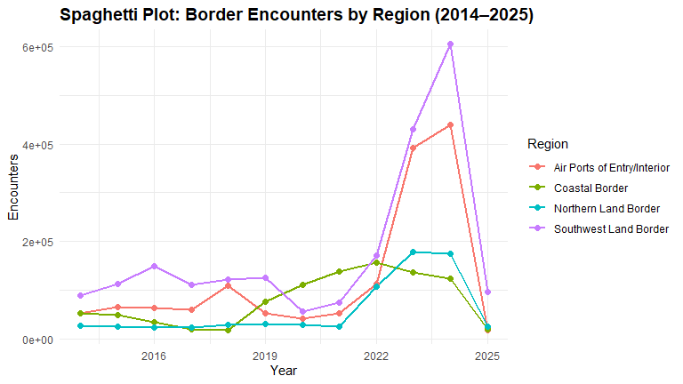

Slide 20
Let’s look at the spikes…
The next question to answer is: what is driving these stark fluctuations?
The graphs reflects the policy changes that have taken place administration to administration.
The most important changes that took place in the context of immigration policy were:
2002: Creation of DHS
2004: Post-9/11 enforcement begins
2012: DACA introduced
2017: Trump’s executive orders
2020: Title 42 and COVID-19 emergency rules
2023: Changes under Biden (e.g., expanded TPS)
To visualize the influence of these milestones, we overlaid vertical reference lines on our spaghetti plot using geom_vline() in ggplot2. These vertical lines highlight key years where policy shifts likely influenced the volume of border encounters — helping us better connect data trends with real-world decisions.

Slide 21
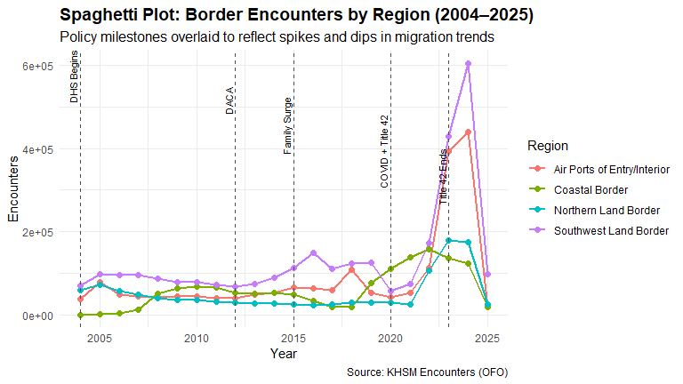
Let’s see it put all together.

Slide 22
Summary
Now that we put all these factors together let’s sum up the data.
Our analysis of the the KHSM Encounters (OFO) dataset starting at 2004 to the present highlights the fact that nothing happens in a vacuum and what may seem on the surface as just numbers is anything but. When taking the time to exam something context matters. In this case, the context consists of policies, people, and life changing pandemics. While most of the borders tend to shift and sway with the times, the Coastal border stayed steady and even increased. I’m guessing people while the world seemed to stop, certain things like the drug trade doesn’t.
Ultimately, our data seems to reflect the fact that immigration is a mirror. It shows how we respond to fear, opportunity, and change.
With that in mind who knows what will happen in the future or what trajectory we will take?

